Slide 1
The convolution neural network based agent vehicle
detection using forward-looking sonar image

Slide 2
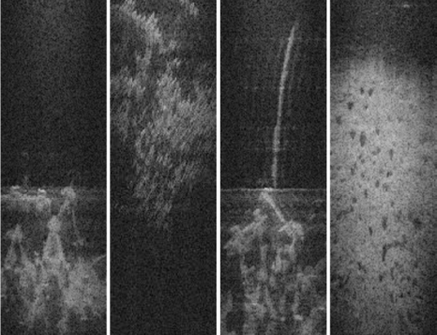
1.Indroduction
Agent vehicle’s recognition
Convolution neural network based agent vehicle detection algorithm
forward-looking sonar image
Independent of lights and turbidity
Low resolution and high noise

Slide 3
2.Proposed method
2.1 Convolution neural network (CNN) based object recognition
CNN for object recognition in sonar images
Have the invariances which is irrelevant to topology changes
local connectivity
shared weights
Object recognition
Properly cropped images are labeled as matching region (Positive)
Snot properly fitted are labeled as non-matching region (Negative)
Notes:
对于图像拓扑的改变具有不变性 局部的连接性，并且能够共享权重

Slide 4
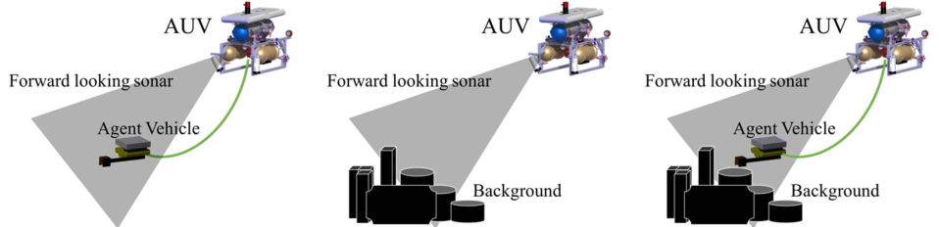
2.Proposed method
2.2 Overall operation strategy
CNN based agent vehicle detection strategy has four steps
1. Take sonar images of agent vehicle and make data-set
2. Explorer the place and take sonar images in advance and make data-set
Train the data-set to the designed neural network
Operate the mission in the place and do object detection of the agent vehicle
step1
step2
step4
Notes:
卷积神经网络针对水下装置检测的步骤
1.拍摄水下装置的声呐图像并制作数据集（正样本）
2.拍摄同一区域的海底情况，背景图片（负样本）
3.用特定的卷积神经网络训练数据集
4.实地使用训练好的检测系统进行目标识别

Slide 5
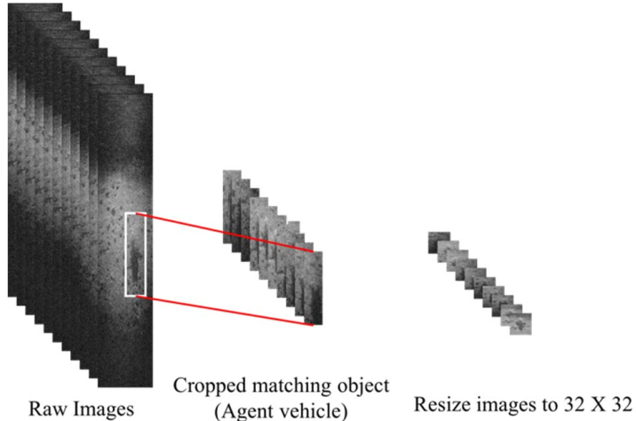
2.Proposed method
2.3 Data-sets of sonar images
2.1.1 target images
96x512 pixels
2500
32x128 pixels
1156
32x32 pixels
1156
Notes:
带有目标物的数据&不带目标物的数据

Slide 6
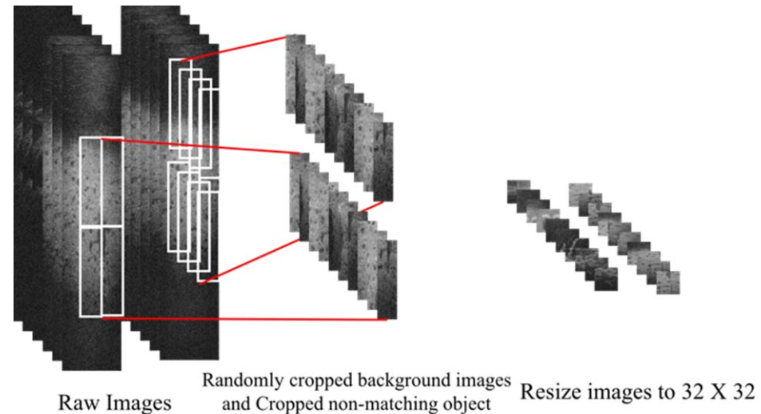
2.Proposed method
2.3 Data-sets of sonar images
2.1.2 background images
96x512 pixels
2500
32x128 pixels
18956
32x32 pixels
18956
Notes:
背景图片：对捕获到的前视声呐图像进行随机的裁剪。一张原图像进行45张图像的扩充

Slide 7
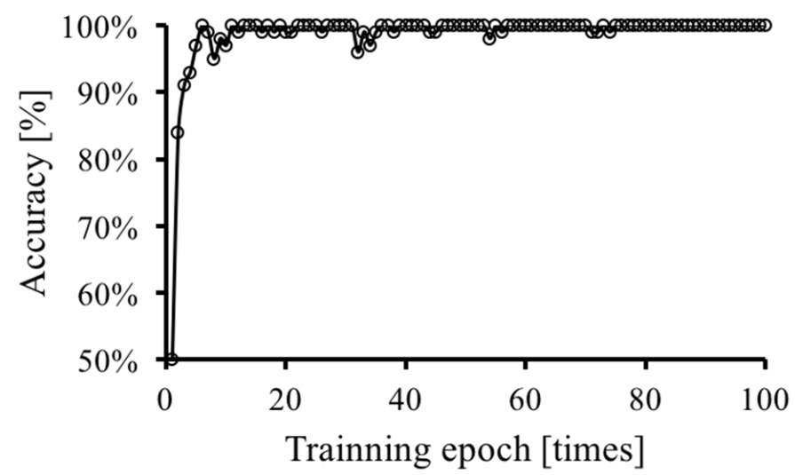
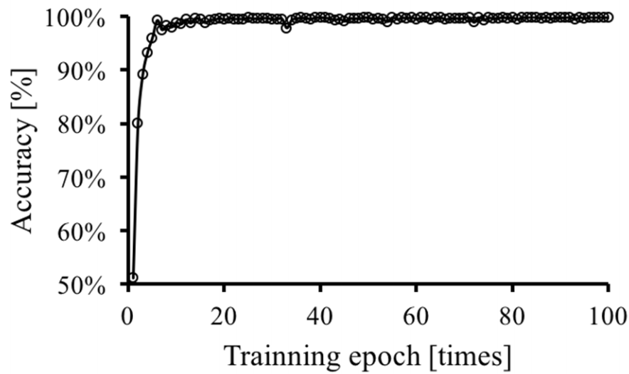
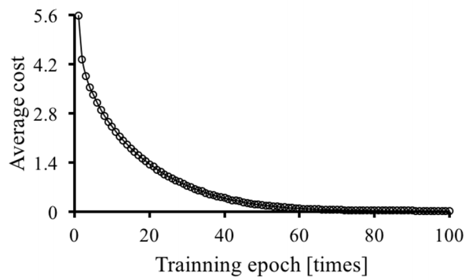
3.Recognition results
CNN based object recognition
400 epochs
99% trainning accuracy
99% testing accuracy
Trainning accuracy
Testing accuracy
Training loss

Slide 8
4.Discussion
Accuracy & speed
Did not verify the non-shadow agent vehicle.
Notes:
目前准确率和实时性的权衡问题（各个领域都存在） 未确认无阴影的目标物

Slide 9
5.Conclusion
Verify the conception/purpose
recognition: whether one is object
classification: classify objects
localization: find certain object (bounding box)
detection: find all objects (bounding box)
segmentation: cut all objects (pixel wise)
Introduction of the advantage of DL processing sonar images
data
Preprocessing method
Number/size/way to gather
Compare with various methods
Notes:
1.明确文章的概念/目的 区分
2.明确的提出深度学习方法对于声呐图像处理的优势，结合声呐图像的物理特点
3.数据集的信息 来源，预处理的方法，训练，测试集图像的数量，大小；没有统一的benchmark,因此用不同的方法来进行结果的比较。

